Slide 1
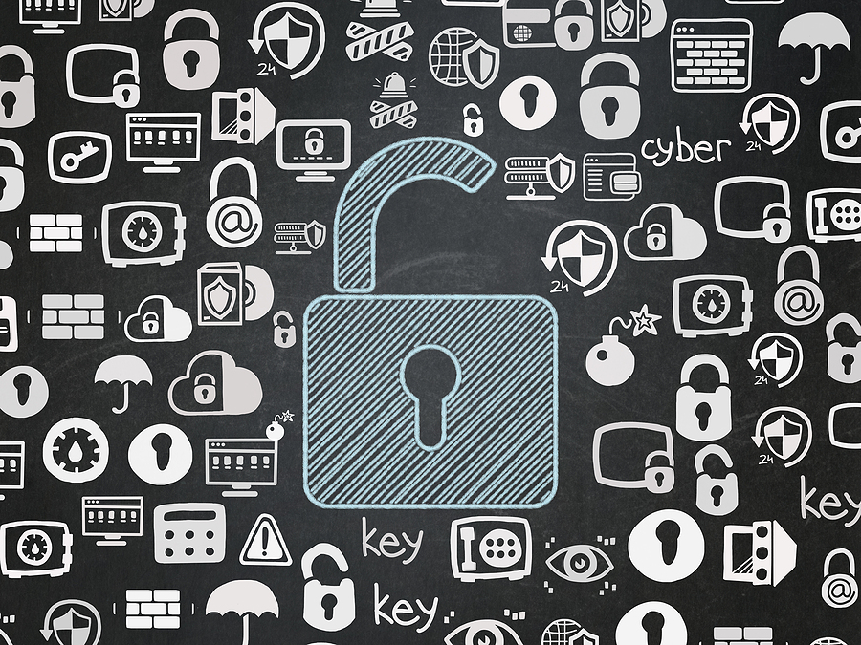
Growing Cybersecurity Risks for K-12 Schools:
Empowering Your Staff with Effective Security Awareness Training

Slide 2
Agenda
CampusGuard Intro
Increasing Cyberattacks, Lessons Learned, and Consequences
Identifying Risks Specific to K12
Recommendations for Building Training Content
Frequency for Training and Ongoing Updates
Gaining Support and Enforcing Requirements
Measuring Effectiveness and ROI
Questions

Slide 3
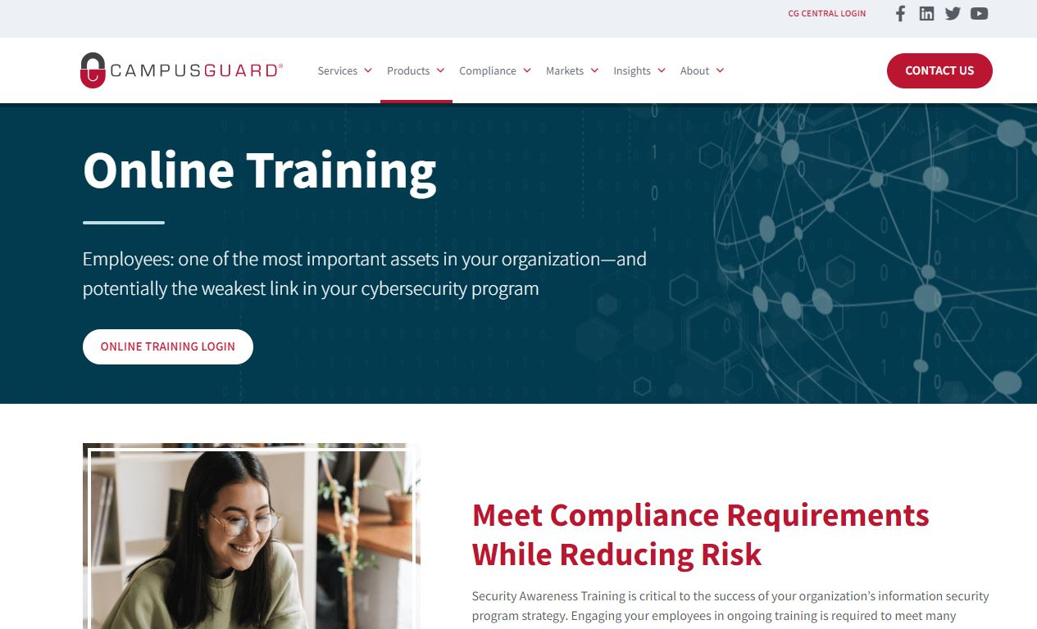
Who We Are
Founded in 2009
Focused on campus/community-based orgs
Services:
IT Security Assessments
Compliance Assessments
PCI, HIPAA, GLBA, GDPR, FERPA, etc.
Vulnerability Scanning
Penetration Testing
Policy and Procedure Review
CampusGuard Central® Portal
Incident Response Plan Testing
Treasury Solutions
Consulting Support
Information Security and Compliance Training

Slide 4
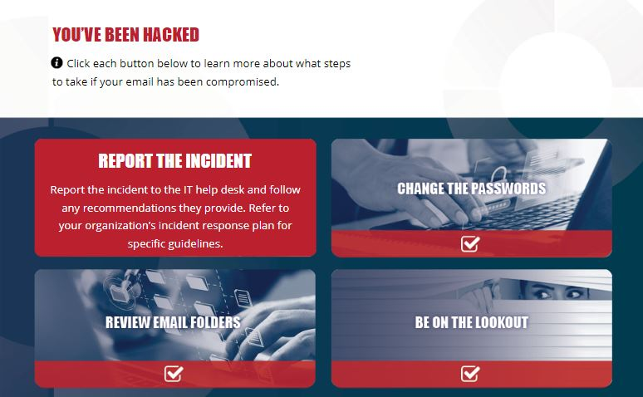
Online Training
Providing online training since 2016
Identified a need in campus and community-based environments
All content created by credentialed CampusGuard experts
Scenarios common in education
Updated annually
Delivered in SCORM format or hosted on CG platform

Slide 5
Increasing Attacks
Data breaches involving student/staff information
Ransomware attacks
Business email compromise (BEC) scams
Denial of service (DDoS) attacks
Website and social media defacement
Online class or school meeting invasions

Slide 6
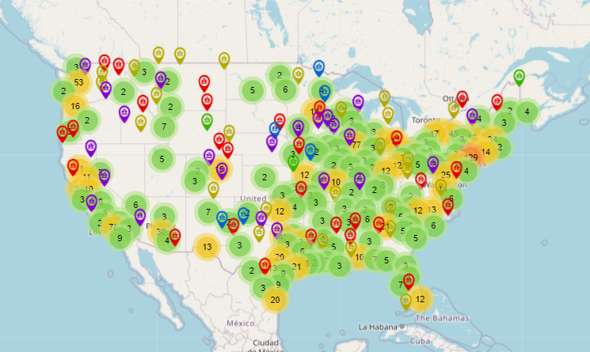
K-12 Incidents K12six.org, the K-12 Cyber Incident Map
Ransomware attacks on K-12 increased by 92% between 2022 and 2023.
Breaches or hacks/disclosure of personal data
Ransomware attacks
Phishing attacks
Denial of service attacks
Other cyber incidents resulting in school disruptions

Slide 7
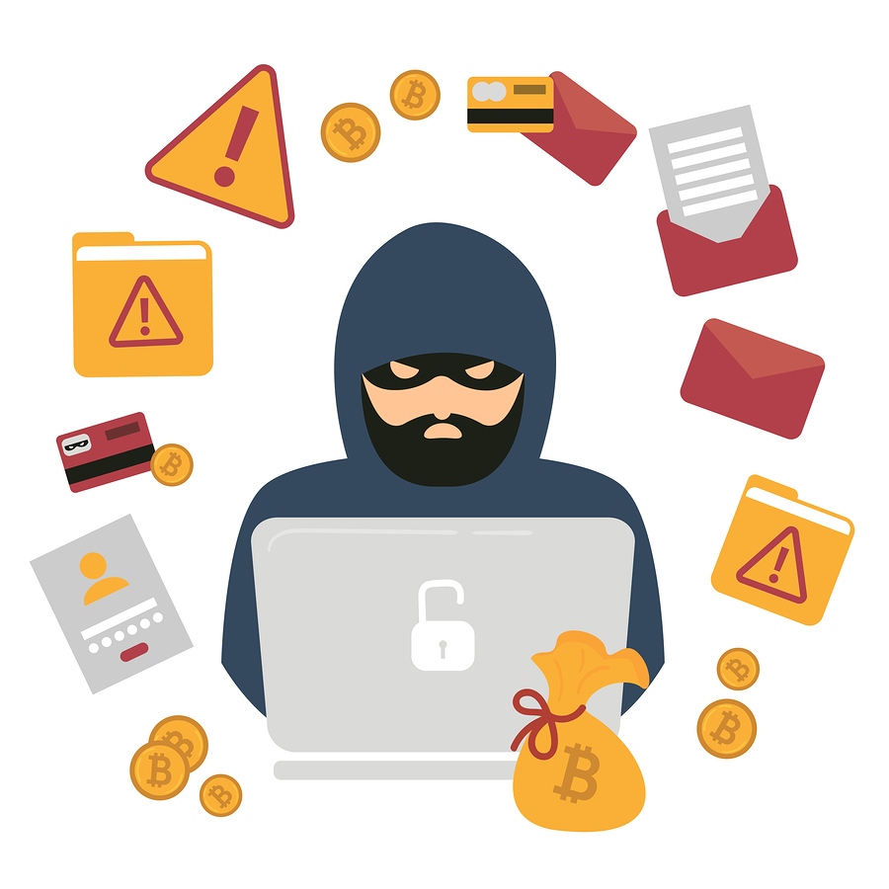
Ransomware
Almost 80% of school IT professionals reported their schools were hit by ransomware in 2023.
Loss of learning time following an attack can range from 3 days to 3 weeks, and recovery time can take between 2-9 months.

Slide 8
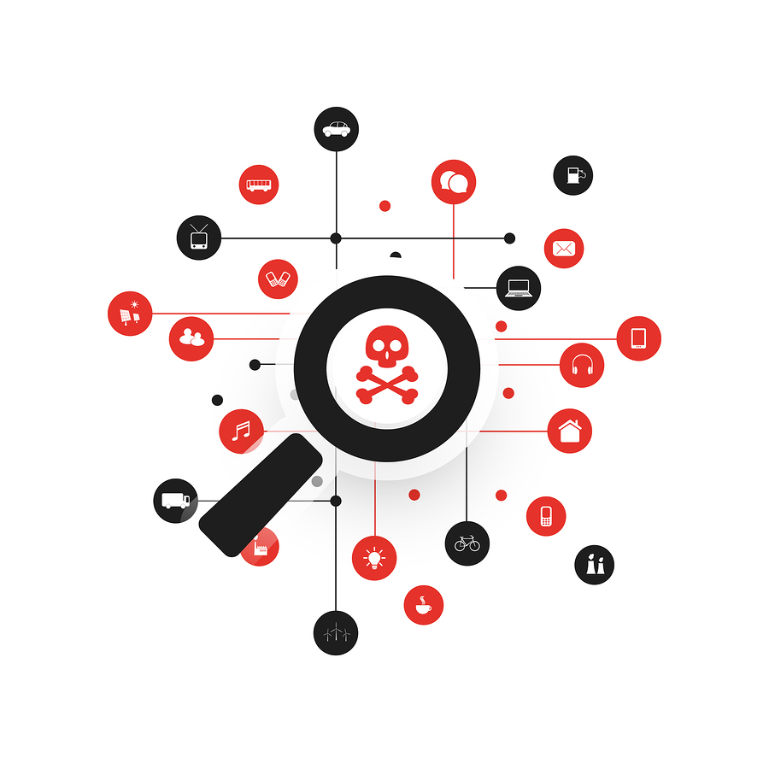
Lessons Learned
Des Moines Public Schools confirmed a ransomware attack that canceled school district-wide for two days.
Mansfield ISD ransomware attack impacting phone, email and website – teacher assignments/agendas inaccessible.
In 2022, following a high-profile attack on the Los Angeles Unified school district, hackers published highly sensitive mental health records of current and former students.
After a breach at Minneapolis Public Schools, the criminal group responsible published civil rights investigation files detailing sexual assault complaints, child abuse inquiries, student mental health crises, and suspension reports.

Slide 9
Breach Costs
Districts have reported losing between $50,000 and $1M per attack.
Buffalo Public Schools in New York spent almost $10 million on recovery efforts after it was attacked in March 2021.
The breach at Baltimore County Public Schools cost approximately $8.1 million.
Private schools – reputation damage can lead to decline in enrollment/donations

Slide 10
Taking Action
FBI, CISA, and the MS-ISAC Top Recommendations for K12 schools:
Deploying multi-factor authentication (MFA).
Mitigating known exploited vulnerabilities.
Implementing and testing data backups and recovery processes.
Regularly exercising an incident response plan.
Implementing a strong cybersecurity training program.
* https://www.cisa.gov/resources-tools/resources/stopransomware-guide

Slide 11
POLL Question

Slide 12
Where do you start?

Slide 13
Focusing on Risk
Perform a risk assessment to determine where your vulnerabilities are.
Outline what the biggest risks are within your various environments, and what areas would result in the most damage if they were to be compromised.
Understand where your data lives.
Target employees or roles responsible for accessing identified systems or handling sensitive data.

Slide 14
Awareness Training Topics
Safe Internet and Computer Use
Mobile devices
Software/Applications
Password Management
Social Engineering
Phishing
Recognizing/reporting potential security threats
Third-party risks

Slide 15
Training Content
High quality content
Adaptable, ongoing, and regularly refreshed
Training on the go, micro-learning
Personalized campaigns, targeted to specific roles
Applicable to personal and professional lives, real-world examples
Customizable/aligns with policy and procedure
Engaging and interactive…FUN
Empowers decisions/behavior change

Slide 16
Frequency/Updates
Required, frequent, targeted
Ongoing (quarterly, monthly)
Smaller, micro-modules
Limited training windows
Consistent messaging
Ongoing evaluation
Staff feedback

Slide 17
Enforcement/Support
Top priority
Leverage compliance (Infosec, PCI, FERPA)
Share risk assessment results
Show the impact of an incident
Involve department leaders
Enforce requirements/accountability

Slide 18
POLL Question

Slide 19
Measuring Effectiveness
Metrics:
Increase in number of personnel completing training
Increase in comprehension (quizzes/training assessments)
Increase in reporting/questions
Reduction in system downtime or network/application outages
Reduction in malware outbreaks and PC performance issues
Reduction in resources spent responding to compromised machines (help desk tickets)
$ Prevention of Expensive Data Breaches $

Slide 20
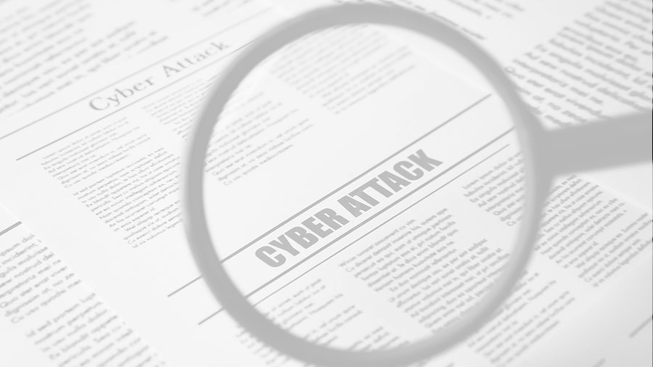
Questions?

