Slide 1
Online Awareness Training Live Demo
Katie Johnson, PCIP
Manager, Operations Support Product Lead, OLT
kjohnson@campusguard.com
Presented by:

Slide 2
Agenda
CampusGuard Overview
Online Training Services
Course Library
Compliance Requirements
Features and Functionality
Training Demonstration
Customization
Support
Questions

Slide 3
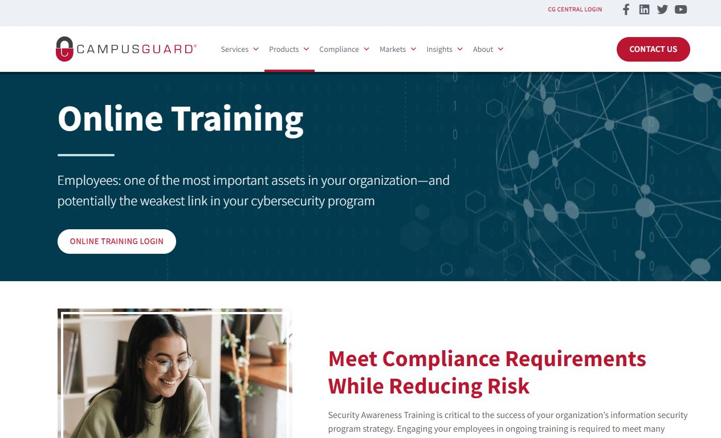
Who We Are
Founded in 2009
Focused on campus and community-based organizations
Services:
IT Security Assessments
Compliance Assessments
PCI, HIPAA, GLBA, GDPR, CMMC, etc.
Vulnerability Scanning
Penetration Testing
Policy and Procedure Review
CampusGuard Central® Portal
Incident Response Plan Testing
Treasury Solutions
Consulting Support
Information Security and Compliance Training

Slide 4
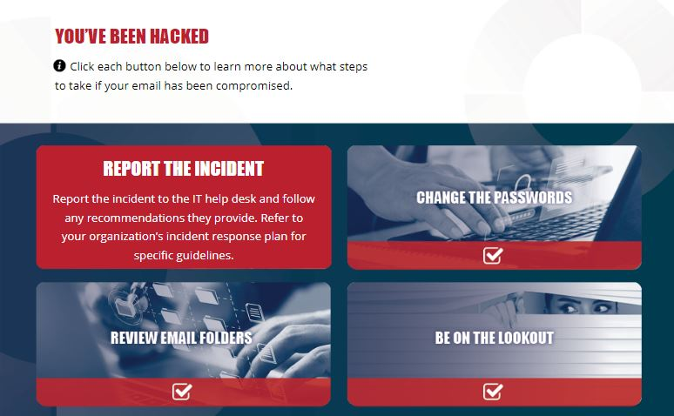
Online Training
Providing online training since 2016
Identified a need in campus and community-based environments
All content created by credentialed CampusGuard experts
Scenarios common in campus-based environments
Updated annually
Delivered in SCORM format or hosted on CG platform

Slide 5
Course Library
HIPAA Compliance
Introduction to HIPAA
Protected Health Information
Who is Required to Comply with HIPAA
HIPAA Privacy Rule
HIPAA Security Rule
Security of PHI
Data Breaches and Reporting
HIPAA Compliance
Information Security Awareness
Information Security
Data Classification and Protection
Social Engineering
Email Security
Password Management
Remote Work Environments
Incident Management
Internal Controls
Security Components
Physical Security
Cyber Crime
Internet Usage
Security at Home
Data Breaches and Compromise
Third-Party Risks
Travel Security
ChatGPT/AI Security (Coming soon!)
PCI DSS Compliance
PCI for Merchants
PCI for IT
PCI for Executives
PCI for Students/Cashiers
PCI DSS v4.0 Overview
GLBA
Introduction to GLBA
Privacy Rule and Safeguards Rule
FERPA
FERPA Overview
Common Scenarios (and how to respond)
FACTA Red Flags
FACTA Red Flags Overview
Identifying and Responding to Red Flags
Phishing Awareness
Phishing 101
Rules for Spotting Phishing
Phishing Practice

Slide 6
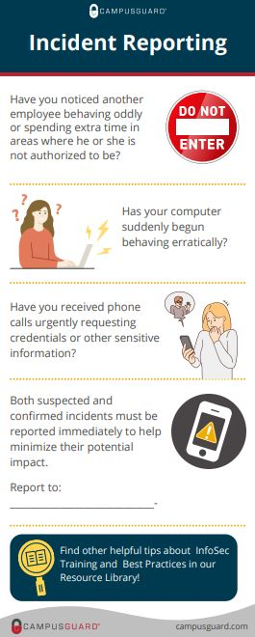
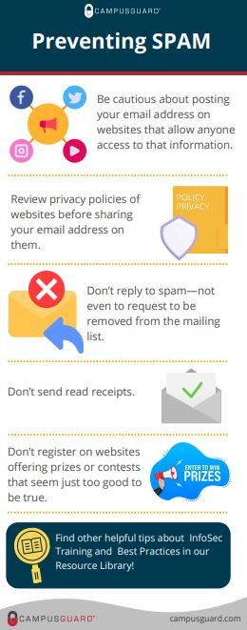
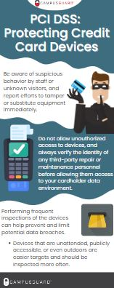
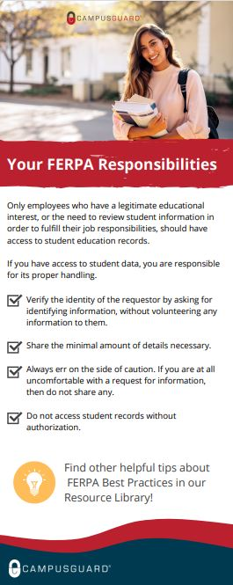
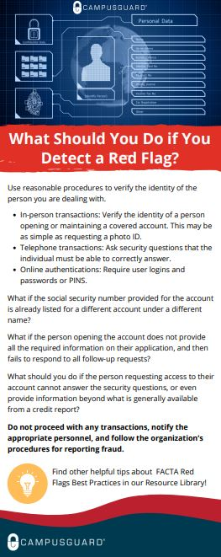
Resources/Content

Slide 7
Compliance Requirements
Standard | Staff | Training Requirement
Information Security | All staff | Annually/ongoing (state requirements cybersecurity insurance).
PCI DSS v4.0 | All staff involved in the payment card process | Security awareness at hire, annually thereafter. Training on the POI, device inspections, social engineering, phishing, acceptable use, and incident response. Refreshed annually.
GLBA/Safeguards Rule | All staff interacting with covered customer financial data | Provide specific training around the risks identified in your annual risk assessment, Training must be kept up to date. Security team must maintain knowledge relevant to threat landscape.
HIPAA | All individuals accessing PHI data | All staff must receive training under the Privacy and Security Rule. Organization must document training materials and workforce completion.
CMMC | All individuals accessing sensitive unclassified data (i.e. research data) | Organizational system users are to be trained on the specific risks associated with their use of in-scope systems. Training should include how to recognize potential threats (insider threats, social engineering, etc.).
FACTA Red Flags | All staff interacting with consumer data and covered accounts | Training should be part of your Identity Theft Prevention Program, teaching employees how to identify red flags, prevent and mitigate identity theft.
FERPA | All faculty/staff with access to student records | Training of the requirements relating to the privacy and security of Personally Identifiable Information (PII) in student records.

Slide 8
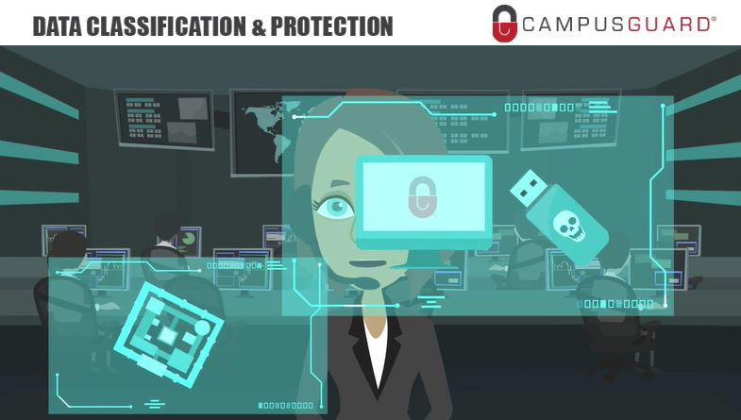
Functionality
Mobile Friendly/Responsive Content
Interactive, Gamification, Videos
Diversity/Inclusion
Flexible Course Structure
Knowledge Tests/Quizzes
Policy Acknowledgements
Narration, Closed Captioning
Accessibility – VPAT WCAG Level AA
SCORM files or CG-Hosted

Slide 9
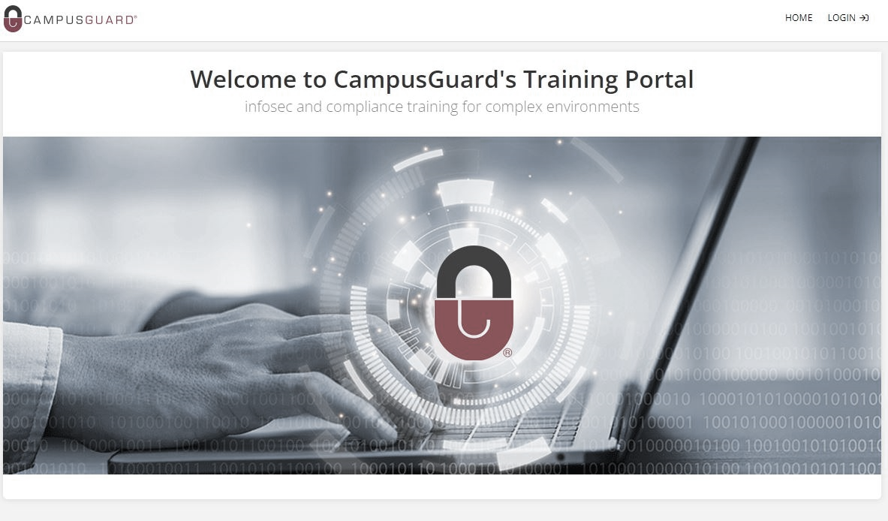
Functionality
LIVE DEMONSTRATION

Slide 10
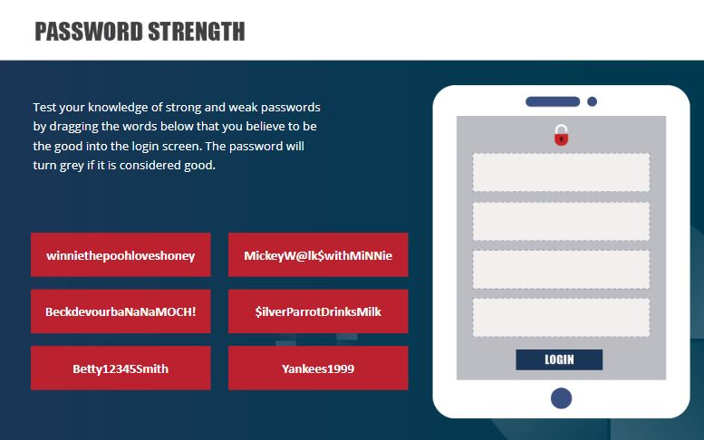
Customization
Branding
Content Customization
Contacts
Links to policies
Additional info
Navigation/Completion Criteria
Knowledge Tests

Slide 11
Implementation/Support
CampusGuard Operations Support Team
Implementation/Configuration
Customization/File Delivery
Ongoing Support
Templates
Best Practices
Annual Content Updates
Dedicated Customer Relationship Manager
Operations Support
Access to credentialed experts

Slide 12
Questions?

