Slide 1
Welcome to the TPA Webinar Series
The Payments Academy
Education, Collaboration, Leadership
June 12, 2024

Slide 3
Evaluating E-commerce Third Parties: It’s a Party!
Presented By:
Pete Campbell, CISA, CISSP, QSA
PCI Practice Lead
CampusGuard
Allison Zwaschka, PCIP
Customer Relationship Manager
CampusGuard

Slide 4
Agenda
About CampusGuard
E-commerce Models
Classifications Based on the Security of Payment Card Data
Scenario 1 – What You Don’t Want to See
Scenario 2 – More of What You Don’t Want to See
TPSP Management
Questions?

Slide 5
About CampusGuard
Founded in 2009
Focuses on campus & community-based orgs
Services:
IT Security Assessments
Compliance Assessments (PCI, HIPAA, GLBA, GDPR, FERPA, etc.)
Vulnerability Scanning
Penetration Testing
Policy and Procedure Review
CampusGuard Central® Portal
Incident Response Plan Testing
Treasury Solutions
Consulting Support
Information Security and Compliance Training

Slide 6
E-commerce Models
‘Fully-fully outsourced’ – reputational risk only
Fully outsourced – your infrastructure is not in scope
URL redirection from your environment (*.edu)
Embedded payment form hosted in your environment

Slide 7
Classification Based on the Security of Payment Card Data
Could Impact
Web Hosted Redirect
Embedded Payment Form
Directly Interacts
Payment Gateway
Payment Processor

Slide 8
Welcome to University of CampusGuard

Slide 9
Scenario 1: Campbell Event Registration
“This diagram shows we have no access to the data."
“Oh that, doesn’t apply to us. We use Big Gateway.”
“We’ve never been asked this before."

Slide 10
3 months later…

Slide 11
Scenario 2: E-commerce Made Easy
“You know you’re a service provider, right?”
“Let’s talk about your responsibility matrix.”

Slide 12
Hat Trick

Slide 13
Third-Party Service Provider Management

Slide 14
Due Diligence & Review
Clarify Merchant of Record
Determines E-commerce Model
Data Flow Diagram
Who is involved?
How is data transmitted?

Slide 15
Due Diligence & Review
Reviewing the AOC – 2a and 2b from AOC for Service Providers
Does it cover the correct services?
Are the dates valid?
Is there a valid QSA listed?

Slide 16
Due Diligence & Review
Documented Roles and Responsibility
Doesn’t have to be a matrix
Covers all requirements
Agreed upon by all parties
DNA, Notarized Deed, Presidential Order, and NDA not required

Slide 17
Contract & Agreements
Safeguards within a Contract
Acknowledgement of responsibility
Notification of breach
Will supply documentation of compliance upon request
Maintaining compliance and termination options

Slide 18
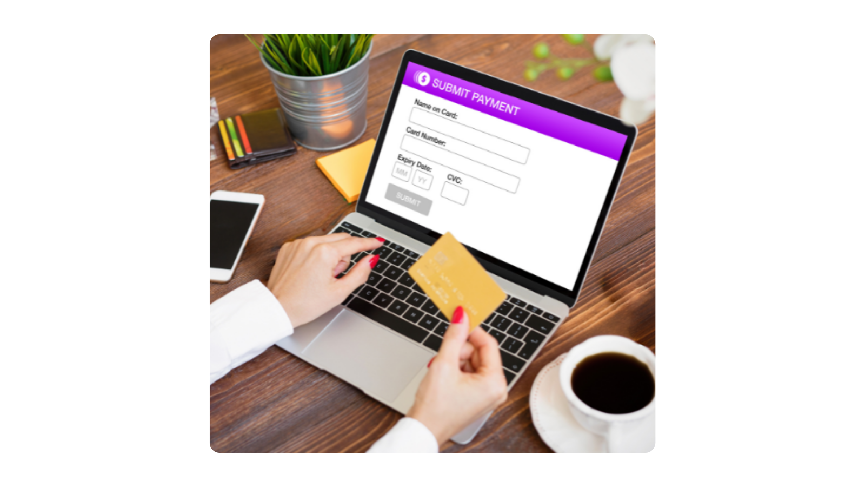
Inventory Listing
Tracking TPSP
Contact Info
Services Provided
Merchant of Record
URL to Final Payment Page/Form
Scanning Responsibility
Compliance Dates
You track them but do they track you?

Slide 19
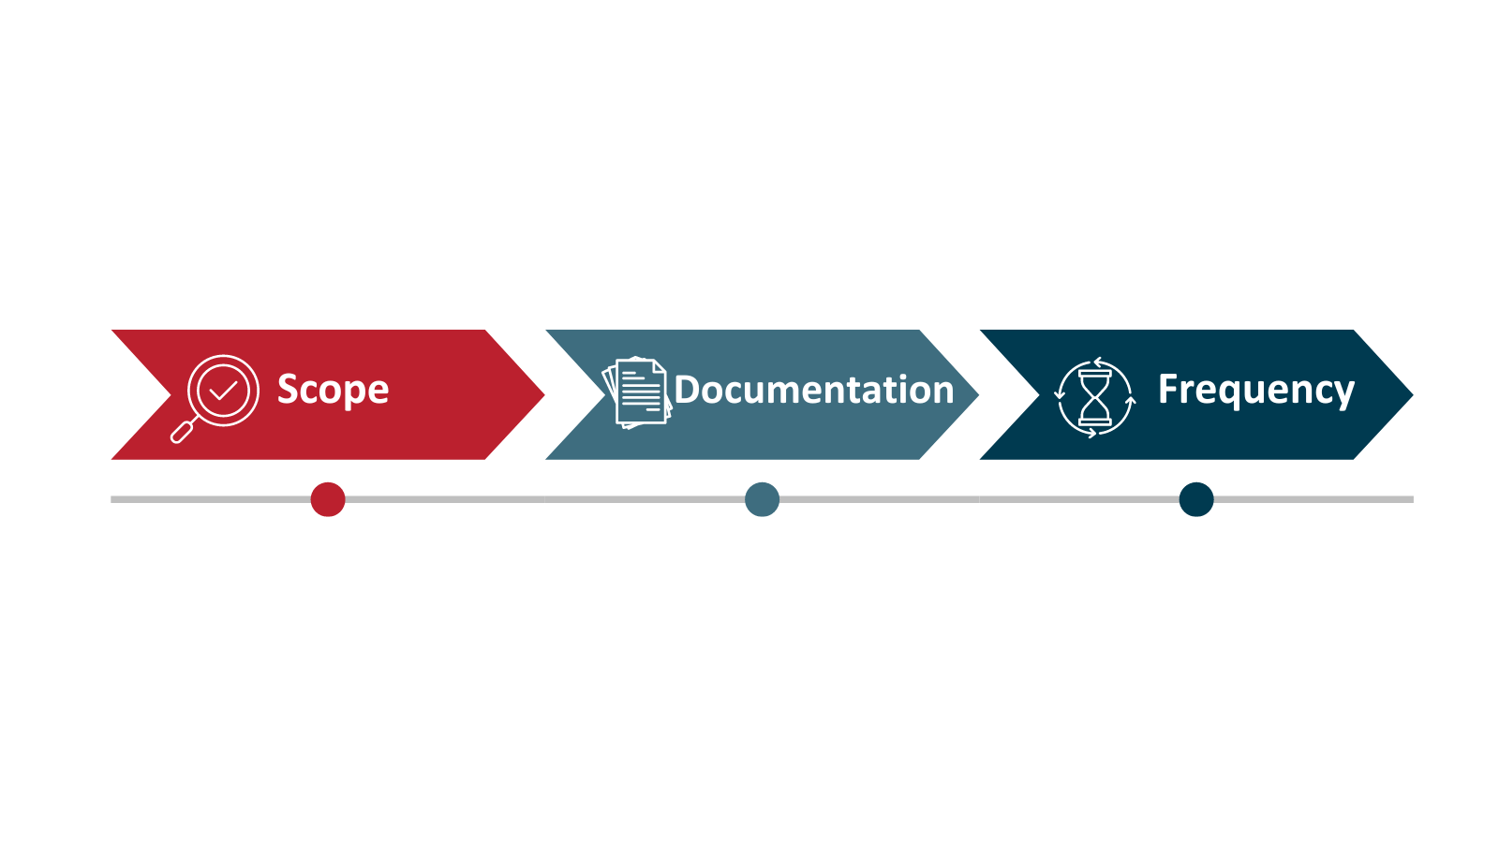
Ongoing Compliance

Slide 20
Glitch in Matrix
Departments ALWAYS follow the process, right?

Slide 21
Accidentally Becoming a
Service Provider
Model 1 with a twist

Slide 22
Questions?
Contact Us:
campusguard.com/contact-us/

Slide 23
Date | Foundational Supporter | Topic/Title | Registration Opens
June 12, 2024 | CampusGuard | Evaluating E-commerce Third Parties: It’s a Party! | Event Completed
August 14, 2024 | Bluefin | An Update on Fraud Prevention and Security | July 18, 2024
October 16, 2024 | Nacha | - under development - | September 19, 2024
December 11, 2024 | The Payments Academy | Prepare for TPA 2025 | November 14, 2024
February 12, 2025 | J.P. Morgan | - under development - | January 16, 2025
April 9, 2025 | Arrow Payments | - under development - | March 13, 2025

